Slide 1

Interrupt Handling
Soham Tupe 331059 21810328
Saurabh Velankar 331062 21810493
Shubham Shinde 331052 21810526

Slide 2
What is an Interrupt?
Interrupts are signals sent to the CPU by external devices, normally I/O devices. They tell the CPU to stop its current activities and execute the appropriate part of the operating system.
Interrupts are important because they give the user better control over the computer.
Without interrupts, a user may have to wait for a given application to have a higher priority over the CPU to be ran. This ensures that the CPU will deal with the process immediately.

Slide 3
Types of Interrupts
Hardware Interrupts are generated by hardware devices to signal that they need some attention from the OS
a)Mask-able
b)Non Maskable
Software Interrupts are generated by programs when they want to request a system call to be performed by the operating system.
.

Slide 4
Classes of Interrupt with Examples
Program Interrupt
Timer Interrupt
I/O Interrupt
Hardware Interrupt
Need of Interrupts ?
So What is the Solution ?

Slide 5
Interrupt handling
An interrupt handler, also known as an interrupt service routine or ISR, is a special block of code associated with a specific interrupt condition.
Interrupt handlers are initiated by hardware interrupts, software interrupt instructions, or software exceptions, and are used for implementing device drivers or transitions between protected modes of operation, such as system calls.

Slide 6
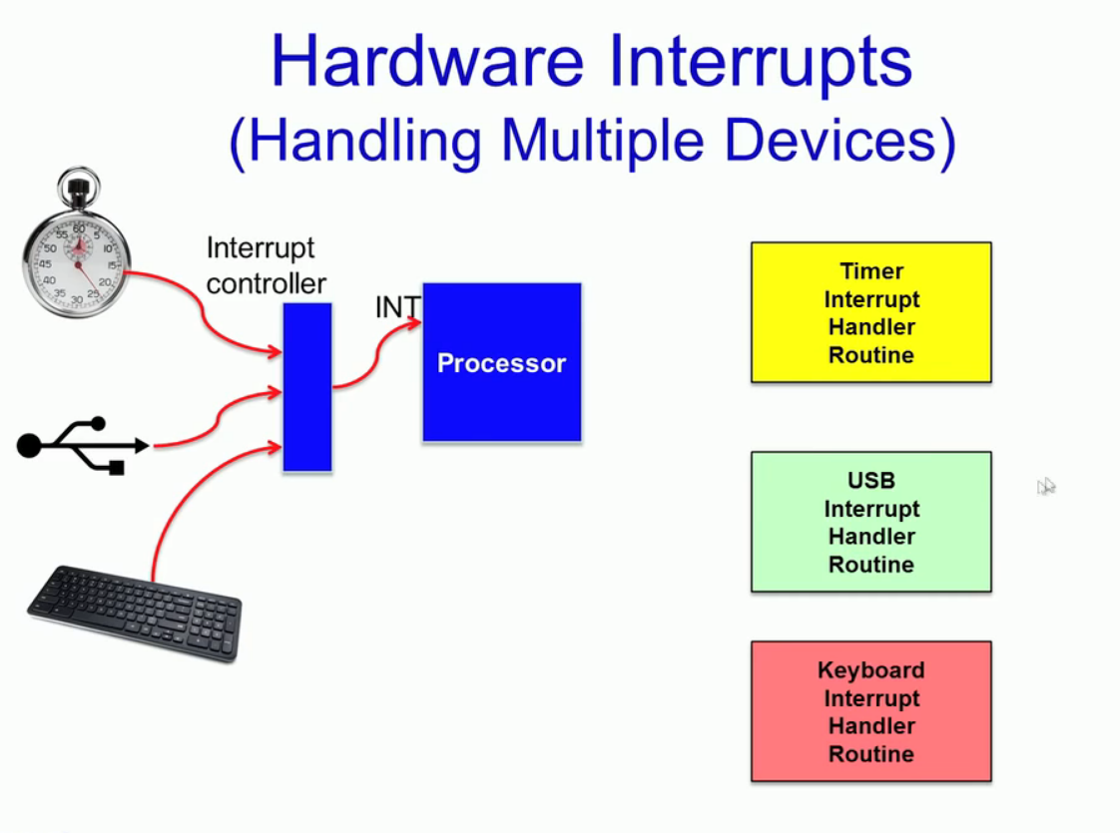
Handling Interrupts

Slide 7
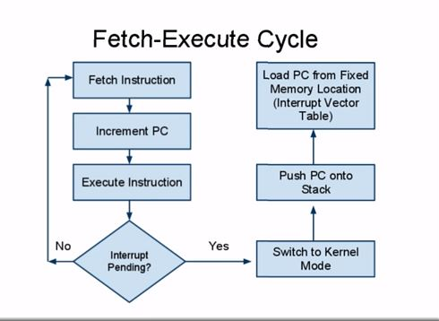

Slide 8
Types of Interrupt Handlers
Two Levels of interrupt handling
Fast
Slow
Fast handlers are invoked directly from their vector tables, and execute in real time
Slow handlers are invoked at a later time and has a lower priority
Tasks are fed in the OS task queue
Executed whenever CPU is not executing fast interrupts.

Slide 9
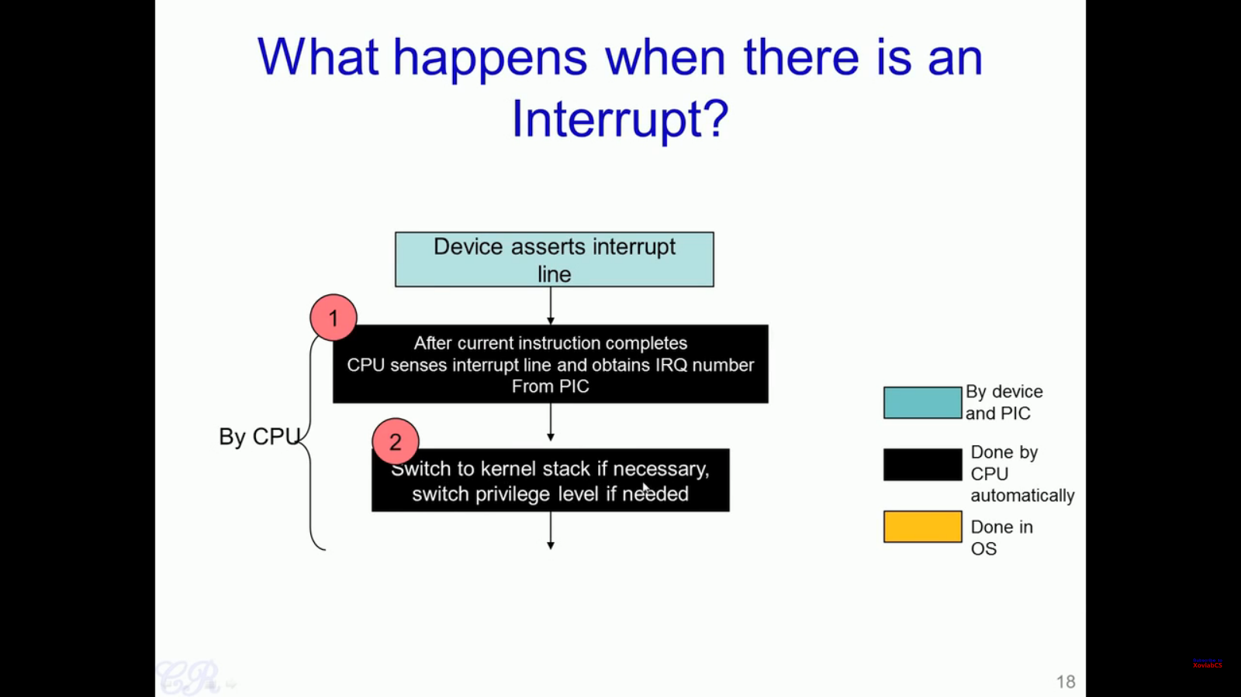
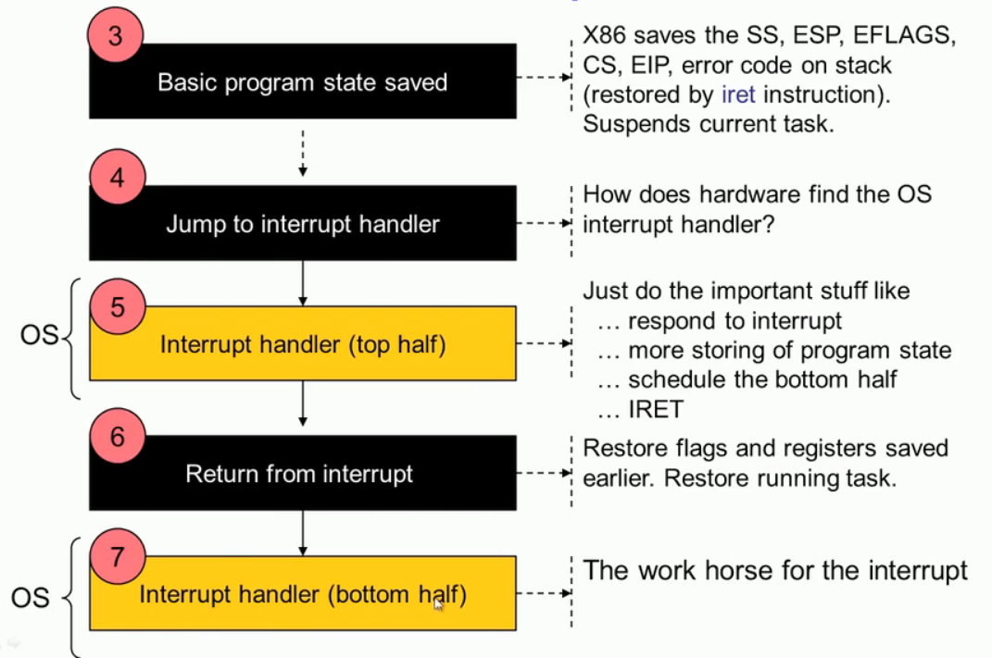
Interrupt Handling Algorithm

Slide 10
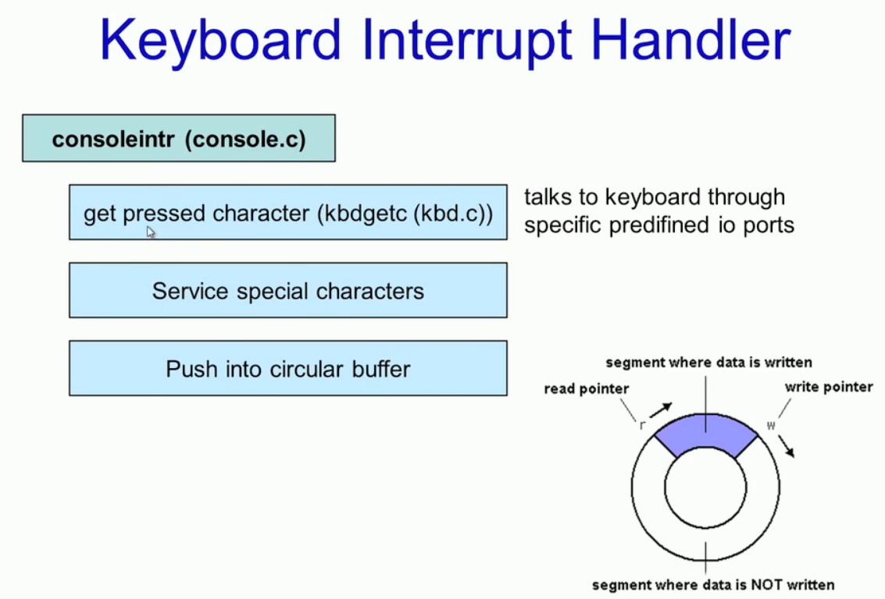
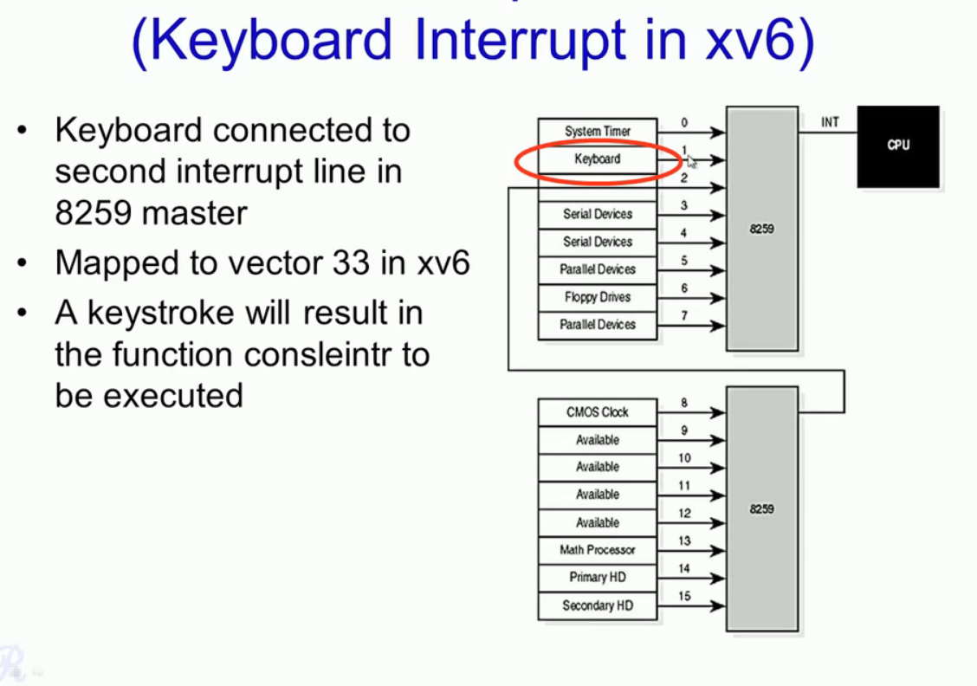
Case Study:

Slide 11
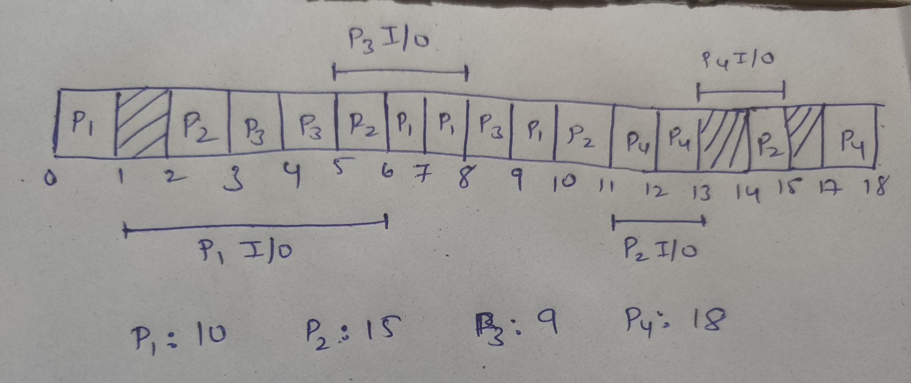
Process | Arrival | Priority | CPU | I/O | CPU
P1 | 0 | 2 | 1 | 5 | 3
P2 | 2 | 3 | 3 | 3 | 1
P3 | 3 | 1 | 2 | 3 | 1
P4 | 3 | 4 | 2 | 4 | 1
Mode: Preemptive
Criteria: Priority Based
Find CT for all processes.

Slide 12
THANK YOU!

